Slide 1
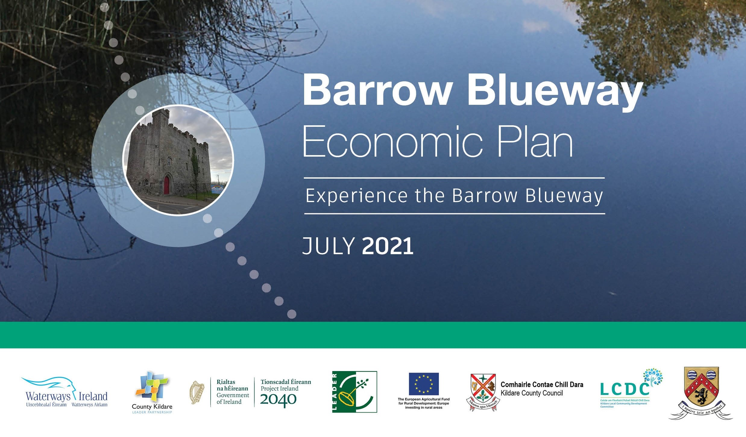
The Market Opportunity
Helen Mulhall
Rural Development Officer
County Kildare LEADER Partnership
Accessible Market Research

Slide 2
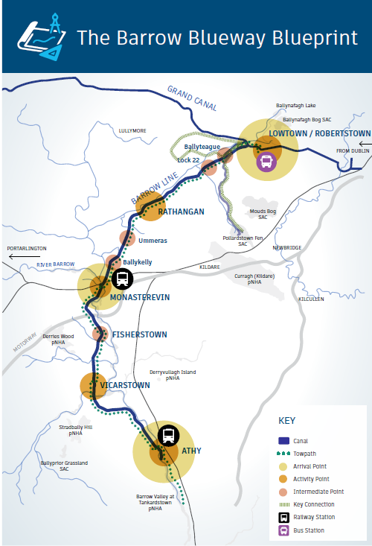
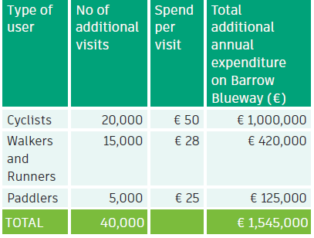
The Economic Opportunity
Additional Users
Destination as a system
Interconnected and Interdependent

Slide 3

Guide to Regulation
Workshops to explore potential ideas
Overview of relevant permissions
Directing to appropriate contact

Slide 4
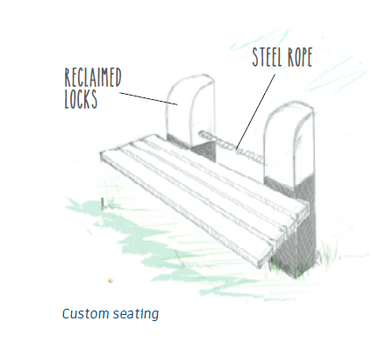

Getting the Word Out
Identity & Interpretation
A series of Interconnected and Interdependent attractions
working together harmoniously to make the Barrow Blueway a Desirable Destination

Slide 5
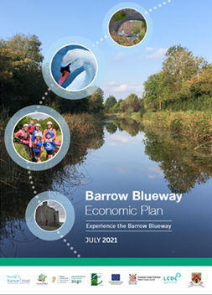

Innovative Businesses
Social Enterprises
Local Clubs
Community Groups
Further Information
Report : www.countykildarelp.ie/bbep
Contact your LEADER Rural Development Officer
Helen Mulhall (Co. Kildare)
helen@countykildarelp.ie 086 836 0901
Jenny Collier (Co. Laois)
jennycollier@laoispartnership.ie 087 458 6515
Local Enterprise Office
Local Sports Partnerships
Barrow Blueway Development: info@kildarecoco.ie

