Slide 1
What are Blueways?
Norma Forrest, WI Marketing & Comms

Slide 2
Blueways Definition
"A Blueway is a network of approved and branded multi-activity recreational trails and sites, based on or closely linked with the water, together with providers facilitating access to activities and experiences"

Slide 3
Blueways Explained
Blueways are a new tourism and outdoor recreation offering that encourage more people to enjoy outdoor activities.
Blueways offer a range of experiences and reasons to explore different destinations across Ireland.
What unites them is water in all forms: rivers, canals, lakes and the coast. Blueways offer experiences in, on and alongside the water that everyone can enjoy.

Slide 4
Bringing Blueways to Life
Service Providers - Cycle Hire, Canoe Trips, SUP instructors, Walking Guides
Visitor Services - Places to Stay, Eat and Go; reasons to stay longer
Inspiration and Creativity - it's all about the authentic experience and the story...

Slide 5
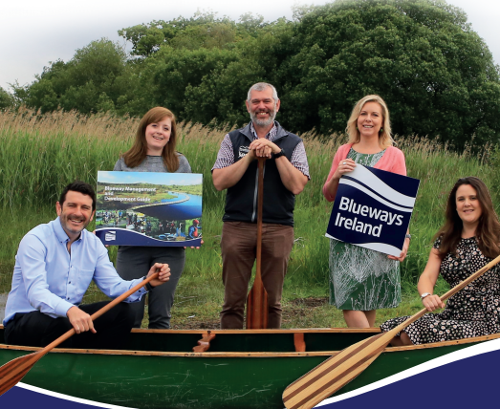
Blueways Partnership
Notes:
Visual of the area to be developed as Blueway region by end 2016

Slide 6
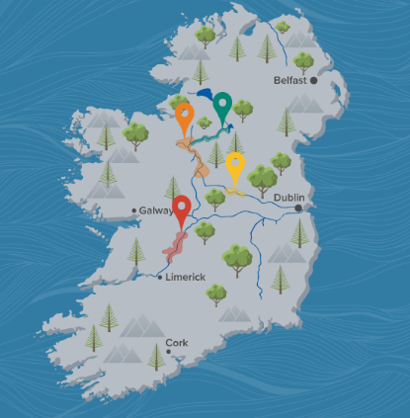
Waterways Ireland’s Blueways
Developed
North Shannon
Shannon-Erne
Lough Derg
In Development
Lower Bann
Barrow Line
Notes:
350km Paddling Trails; approx. 50km of land based trails

Slide 7
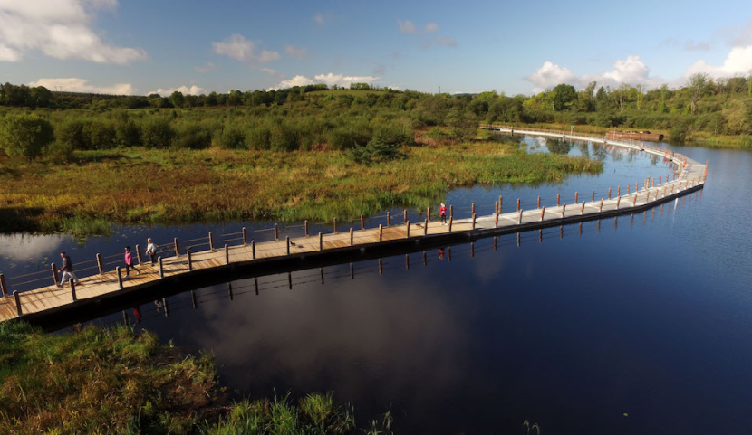

Slide 8
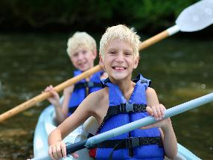
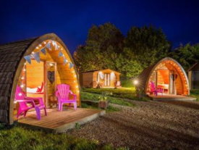
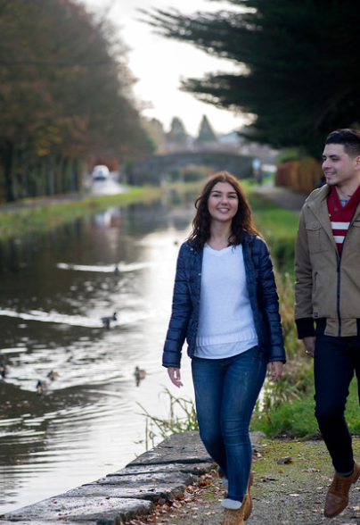
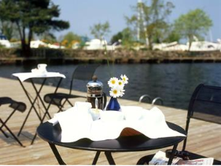
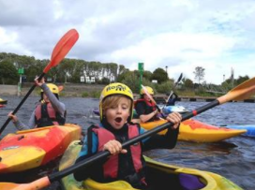
Blueway Brand Promise
Notes:
Visual of the area to be developed as Blueway region by end 2016

Slide 9
Consumer Insights

Slide 10
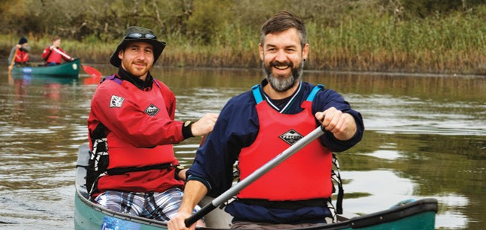
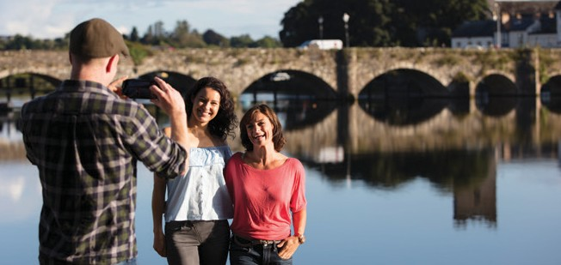
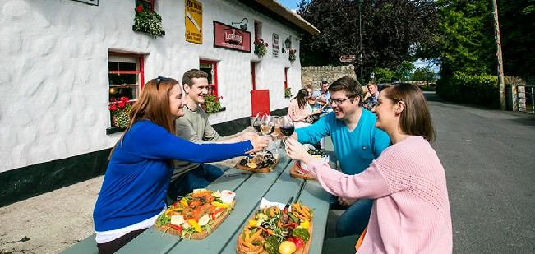
Who is the target audience?
The “Dabbler” - wants fun and enjoyable experiences rather than challenging ones.
ENTHUSIASTIC NOT SEEKING FUN NOT LOOKING HIGHLY ACCOMPLISHED! FOR SOMETHING STRENUOUS
LIGHT-HEARTED NOT
SERIOUS AND FOCUSED

Slide 11
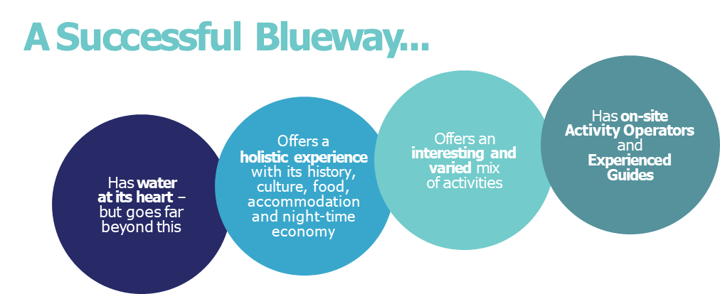

Slide 12
Who is the target audience?
UNDER 30s Blueway experiences and activities are among the many options open to this free and easy group. Generally speaking, Blueways appeal more to domestic visitors aged under 30 than international visitors. | YOUNGER FAMILIES While some activities in and around water will appeal to this group, managing small children around water creates challenges. | OLDER FAMILIES For families with kids in their early teens, Blueways are a godsend. They offer excitement, new experiences and surroundings – and the chance to spend time together as a family, away from screens. | ADULTS 55+ People with more time and fewer responsibilities are especially enthusiastic about Blueways. They can set their own pace, explore and enjoy a wide variety of experiences – and if they’re feeling daring, they can dial up the excitement levels.
Research would indicate that the Older Families and Adults 55+ segments present THE GREATEST OPPORTUNITIES FOR BOTH DOMESTIC AND INTERNATIONAL VISITORS.

Slide 13
What’s in the “Shop Window”?
Activity-Based Experiences
Making Access Easy
Removing the Barriers
Soft Adventure
Accommodation and Activity
Context of Wider Tourism Offering
Wide range of Marketing Tactics

Slide 14
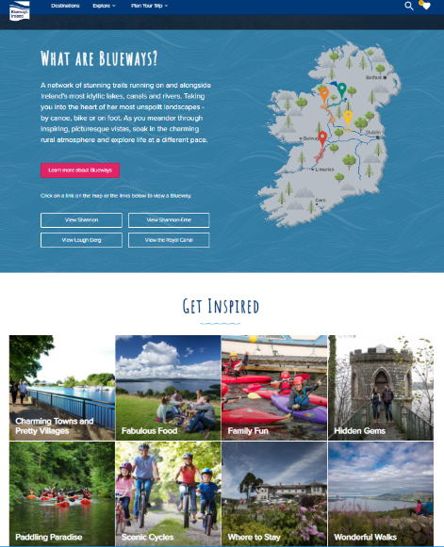
Digital
www.bluewaysireland.org
Inspiration
Itineraries
Experiences
Packages / Offers
Themes
Destinations
Notes:
The website also showcases events, such as the Blueway 10k Challenge which is to be launched next week. Get involved and sign up for a new activity!

Slide 15
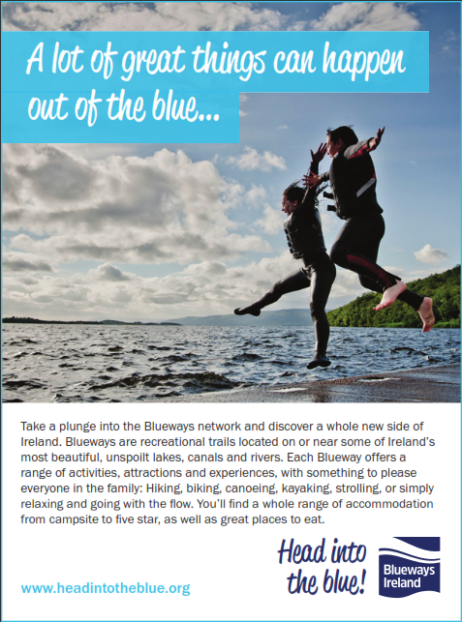
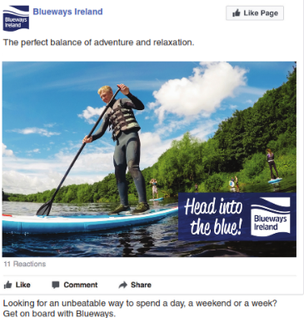
Social

Slide 16
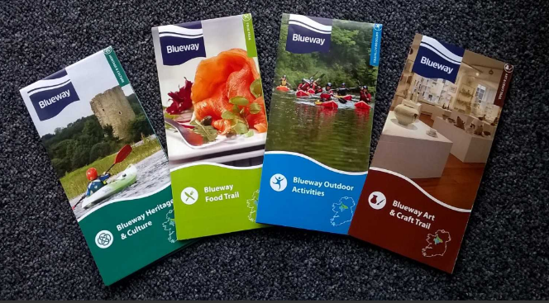
Themes

Slide 17
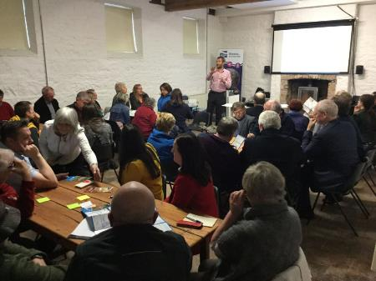
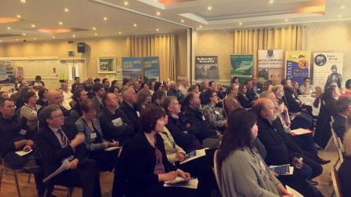
Working Together

Slide 18
3 Take-Aways
Guiding – users want reassurance that they will be expertly and safely looked after
“Après” experience just as important, social aspect
Pulling the experience together – making it real for the customer, packaging, cross-selling, be relevant

Slide 19
Thanks for Listening!
E: norma.forrest@waterwaysireland.org
T: +44 (0)28 6634 6209

